Slide 1
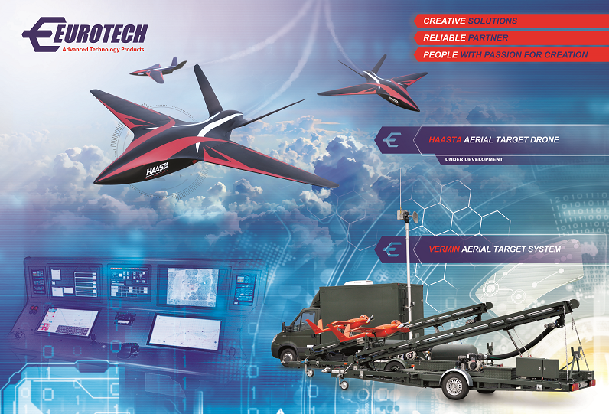
AERONET CONFERENCE, RZESZÓW 2018
Unmanned Aerial Vehicles in Poland
Janusz Michalcewicz, President/CEO

Slide 2


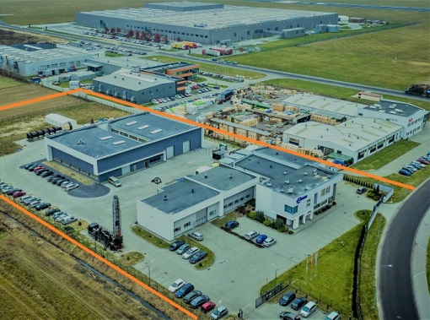
Eurotech offer design and production of CUSTOM MADE advanced technology products and systems. The company provide complex service from conceptual design through production to maintenance and service, delivers high quality wide range of products and services: • Unmanned Aircraft Platforms, Aerial Target Systems and Avionics • Custom Electronics - measurement, control and data acquisition systems • Mobile Equipment and Components for Oilfield industry
One of Eurotech’s priorities is the permanent development through active participation in research projects dealing with novel, promising technologies. Eurotech has established a strong collaboration with Polish and foreign academic research and industrial centers.
The company provide complex service from conceptual design through production to maintenance and service.
Established in: 2001
Employees: >60
Plant surface: 2400 m²
Address: EUROTECH Sp. z o. o.
3 Strefowa str., 39-300 Mielec, POLAND
info@eurotech.com.pl www.eurotech.com.pl

Slide 3

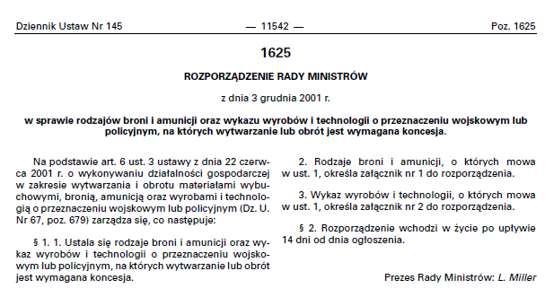
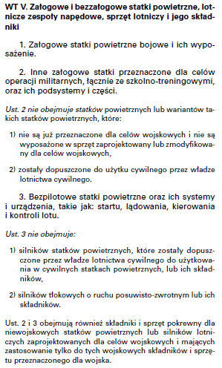
SPRAWY FORMALNO-PRAWNE
WYTWARZANIE UAV/RPAS
Niestety procesy legislacyjne nie nadążają za rozwojem, ale to nie zwalnia przedsiębiorców i inżynierów z odpowiedzialności.

Slide 4
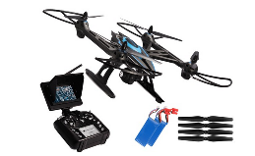
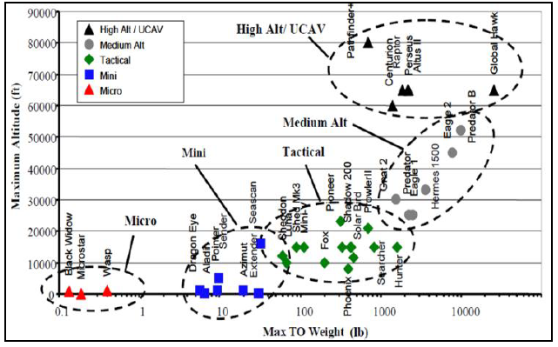
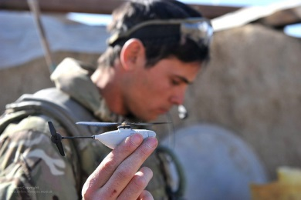
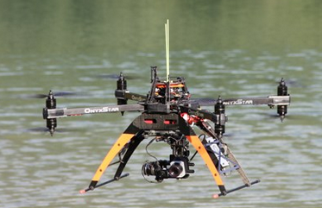
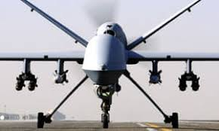
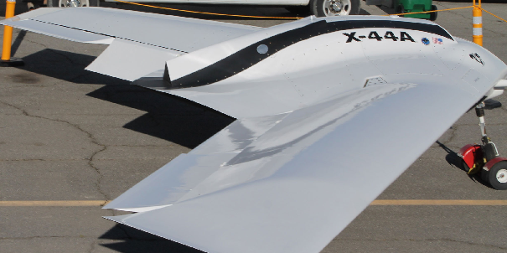
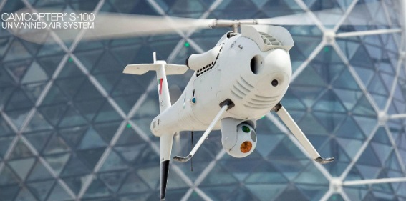
NAZEWNICTWO I KATEGORIE
DRONE - UAV/RPAS

Slide 5
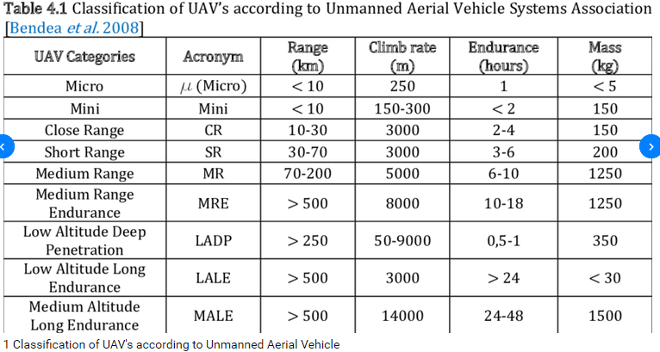
NAZEWNICTWO I KATEGORIE
MILITARNE UAV/RPAS

Slide 6
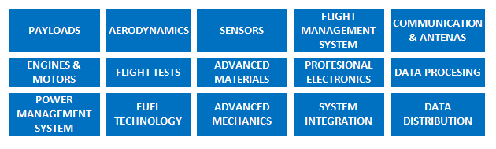
TECHNOLOGIES
FOR UAV SYSTEMS

Slide 7
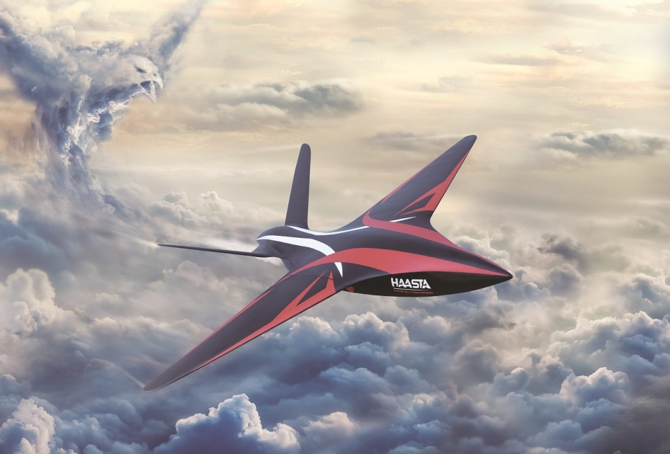
THANK YOU FOR ATTENTION

