Slide 1
Single European Sky ATM Research
Joint Undertaking
Technological trends for UAV:
SESAR 2020 PJ06
SESAR 2020 PJ10.05
Andrzej Majka
Rzeszow University of Technology
The Faculty of Mechanical Engineering and Aeronautics

Slide 2
Vision
The objective of SESAR is to modernise European ATM by defining, developing and delivering new or improved technologies and procedures (SESAR Solutions).

Slide 3
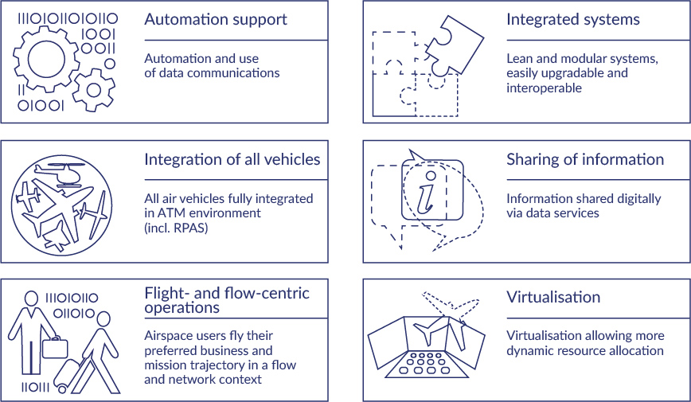
Vision

Slide 4

SESAR 2020 PJ06-02 ToBeFREE
Management of Performance Based Free Routing in Lower Airspace

Slide 5
SESAR 2020 PJ06 ToBeFREE
Management of Performance Based Free Routing in Lower Airspace
Management of Performance Based Free Routing in lower airspace sees the application of FRA for airspace users below FL305, improving predictability, efficiency and flexibility for a wider range of different airspace users.

Slide 6
SESAR 2020 PJ06 ToBeFREE
Management of Performance Based Free Routing in Lower Airspace
Integration of RPAS into the airspace between 500ft and 60,000ft as either IFR or VFR is challenging due to the fact that RPAS will have to fit into the ATM environment with the same level of safety as manned aviation.

Slide 7
SESAR 2020 PJ06 ToBeFREE
Management of Performance Based Free Routing in Lower Airspace
Free Route operations shall allow Airspace Users, including General Aviation, Rotorcraft and RPAS, to significantly optimize flight trajectories over a large-scale area of interest (e.g. multiple FIR or FABs), within high & very high-complexity environments, according to user defined segments

Slide 8
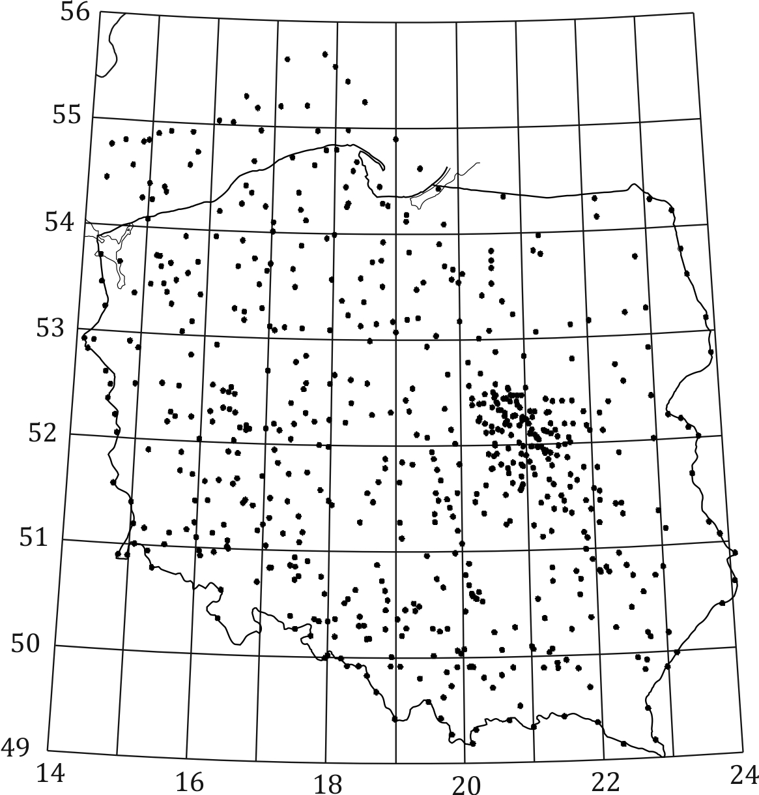
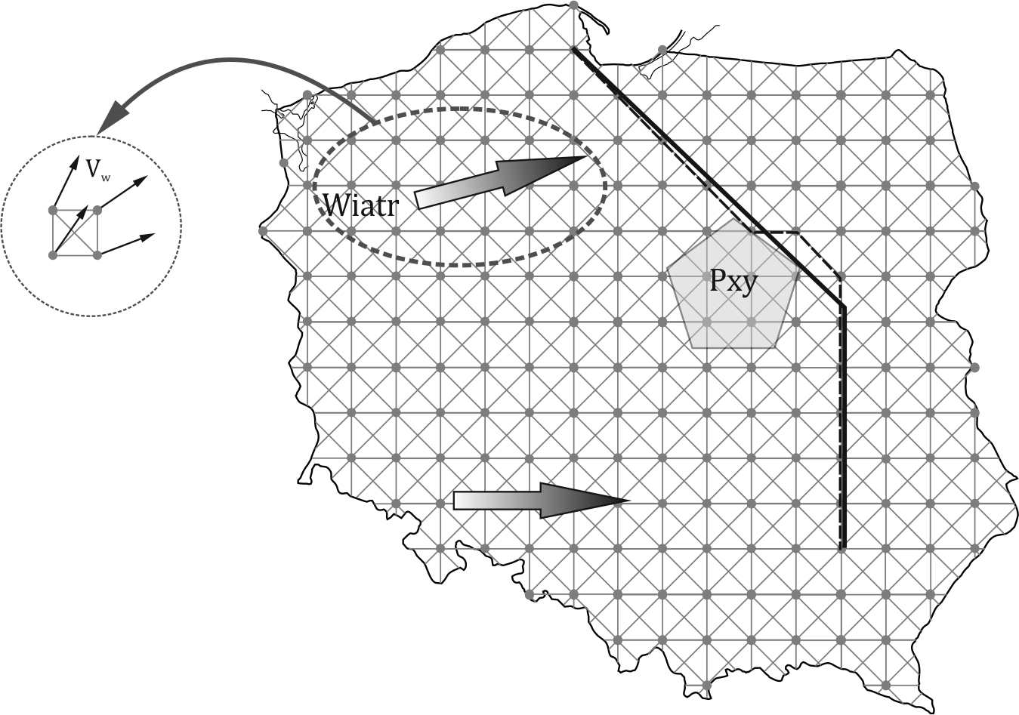
SESAR 2020 PJ06 ToBeFREE
Management of Performance Based Free Routing in Lower Airspace
Rzeszow University of Technology proposed a new flight planning method and airspace model, which can be used for determination of optimal path of aircraft (manned and unmanned), at the stage of preparing a flight plan according to FRA rules.

Slide 9

SESAR 2020 PJ10 PROSA
IFR RPAS Integration

Slide 10
SESAR 2020 PJ10 PROSA
IFR RPAS Integration
This work provides the technical capability or procedural means to allow drones to comply with air traffic control instructions

Slide 11
SESAR 2020 PJ10 PROSA
IFR RPAS Integration
According to Roadmap for the integration of civil RPAS into the European Aviation System (European RPAS Steering Group, June 2013), one of the main goal is to develop harmonised and common rules for operation of the RPAS to open the internal EU market, with priority to RPA of 150 Kg or less.

Slide 12
SESAR 2020 PJ10 PROSA
IFR RPAS Integration
Currently, there is a lack of standardized procedures, technical, and technological requirements regarding RPAS, which are the main obstacles in integration of RPAS in the frames of non-segregated airspace. Technological gaps have been identified in six areas:
detect and avoid systems and operational procedures;
data communication links, including spectrum issues;
surface operations, including take-off and landing and integration into ATM and airspace environments;
contingency;
human factors;
security issues.

Slide 13
SESAR 2020 PJ10 PROSA
IFR RPAS Integration
The majority of RPAS are characterized by worse performance properties in comparison to commercial airliners, despite performing their tasks at similar heights. Generally, lower weight RPAS’s are unable of reaching the vertical acceleration/speeds required for sufficient vertical or horizontal manoeuvres or manoeuvres with wind.

Slide 14
SESAR 2020 PJ10 PROSA
IFR RPAS Integration
According to the scope of the Solution 10-05, for a safe RPAS IFR integration into non-segregated airspace, the RPAS should be compliant with ATM rules and ATC related systems, navigation precision and should be integrated with other manned traffic. Therefore Validation Exercises performed by Rzeszow University Technology were aimed to RPAS realized certified EASA category operations, based on the RPAS class VI Traffic concept of operations of EUROCONTROL.

Slide 15
SESAR 2020 PJ10 PROSA
IFR RPAS Integration
The conclusions will identify the main parameters of RPA performance, in order to accomplish this type of TMA procedures. If it turns out that these performance requirements are excessive, the conclusion will be made that it is necessary to create a new performance subcategory for light RPA (with weight close or slightly higher than 150 kg).

Slide 16
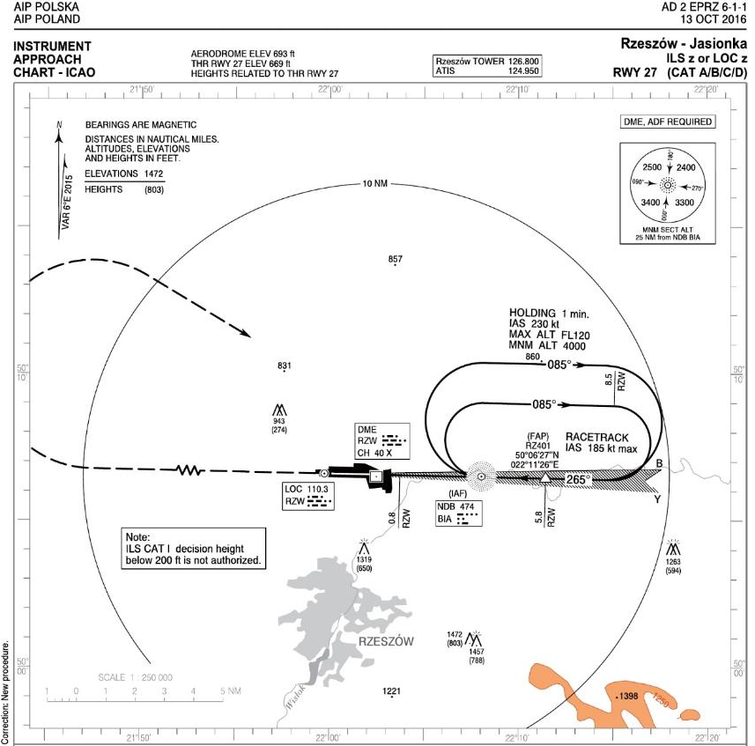
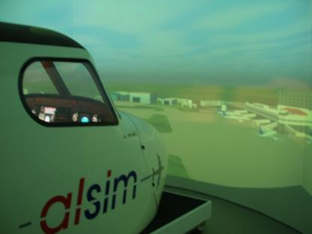
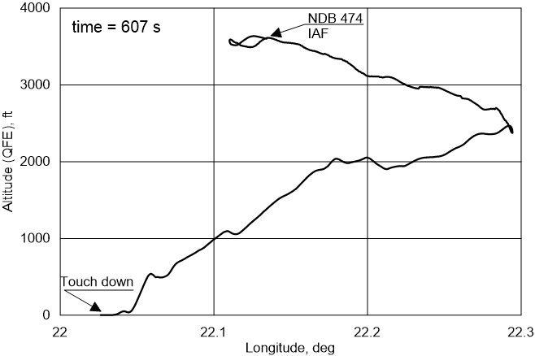

Slide 17
Contact:
Department of Aircraft and Aircraft Engines
Faculty of Mechanical Engineering and Aeronautics
Rzeszow University of Technology
Address:
ul. Powstancow Warszawy 8
35-959 Rzeszow, POLAND
phone: +48 17 865 1604
mobile: +48 602 441 977
web: www.prz.edu.pl/ksisl
e-mail: andrzej.majka@prz.edu.pl

