Slide 1
Perspectives for the Aeronautical Research in Europe (PARE)
Michał Pilecki
Project Manager INNpuls Sp. z o.o.
This project has received funding from the European Union’s Horizon 2020 research and innovation programme under grant agreement No 769220. This publication [communication] reflects the views only of the author, and the Commission cannot be held responsible for any use which may be made of the information contained therein.

Slide 2
Perspectives for the Aeronautical Research in Europe (PARE)
TOPIC MG-1.5-2016-2017
Aim
Identification of:
gaps,
barriers and
needs in the aviation research.
Duration: 36 months (November 2017 – October 2020) Type of action: Coordination and Support Action (CSA)
Notes:
PARE

Slide 3
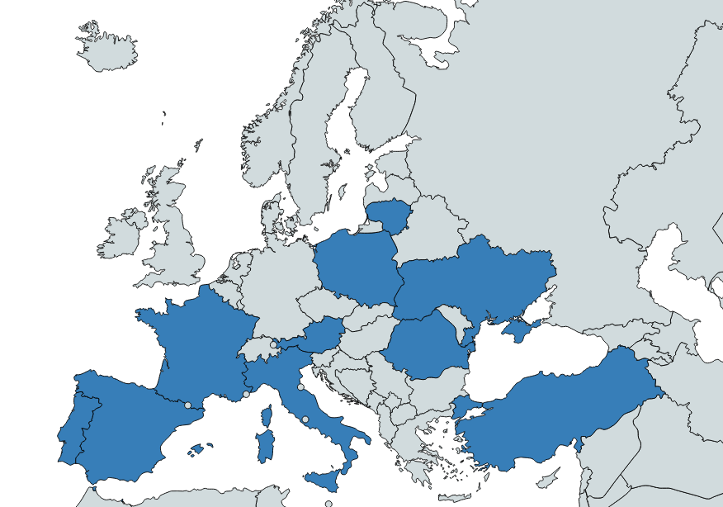
PARE – Consortium (15 partners)
3 consultancy agencies
5 aviation enterprises
1 aviation clusters
6 technical universities and science institutes

Slide 4
PARE - Consortium
No | Participant Organisation Name | Country
1 (coordinator) | Associação do Instituto Superior Técnico para a Investigação e Desenvolvimento (IST) | Portugal
2 | INOVAMAIS, Serviços de Consultadoria em Inovação Tecnológica, S.A. (INOVA) | Portugal
3 | Aporozhye Machine-bulding Sedign Bureau Progresso State Enterprise Named After Academician A.G. Ivchenko (IP) | Ukraine
4 | Airbus Defense and Space SAS (AIRBUS) | France
5 | Universidad Politecnica de Madrid (UPM) | Spain
6 | VARTA Micro Innovation (VARTA) | Austria
7 | Universitatea Politehnica din Bucuresti (UPB) | Romania
8 | National Aviation University (NAU) | Ukraine
9 | FerroNATS Air Traffic Services S.A. (FNATS) | Spain
10 | INNpuls Sp. z o.o. (INNPULS) | Poland
11 | Universita Degli Studi di Salerno (UNISA) | Italy
12 | HAVACILIK VE UZAY KUMELENMESI DENEGI- Katip Celebi University (KCU) | Turkey
13 | Quasar Human Capital, Unipessoal Lda (QUASAR) | Portugal
14 | Vinius Gediminas Technical University (VGTU) | Lithuania
15 | SATA Internacional | Portugal

Slide 5
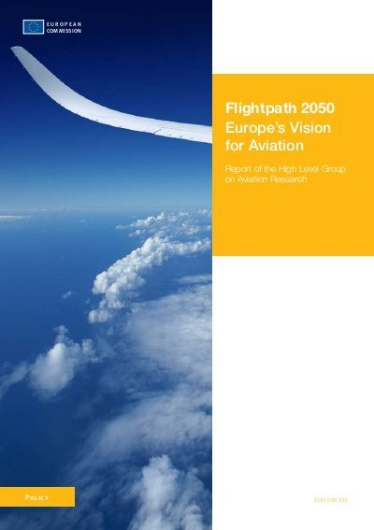
1. Objectives of the PARE
MAIN OBJECTIVE
To assess the progress towards each of the 23 goals of ACARE Flightpath 2050 Europe’s Vision for Aviation and in case gaps are identified suggest means to close them
COMPLEMENTARY OBJECTIVES RELATED TO THE AVIATION SECTOR
Have a special focus on long-range air transport
Identify emerging technologies
Assess the competitive status of aviation worldwide
Seek means to increase the participation of women
Propose ways to attract young talent
Notes:
Complementary Objectives:
Have a special focus on the efficiency, economy and environmental aspects of long-range air transport;
Identify emerging technologies, including those so far developed outside the aeronautical sector, that can contribute to the progress of aviation;
Assess the competitive status of aviation worldwide, with emphasis on areas of mutually beneficial cooperation between the EU and other regions;
Seek means to increase the participation of women in aeronautics by considering relevant influences throughout their life and careers;
Propose ways to attract young talent to the aeronautical sector through initiatives of dissemination and active participation.

Slide 6
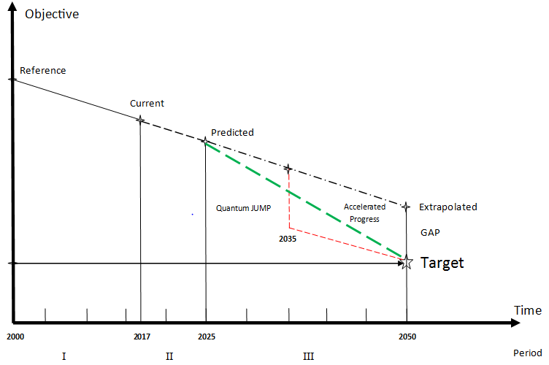
2. Assessment of Progress towards the ACARE Goals
*Sample of a methodology:
Take 2010 as the reference year;
Collect relevant statistics up to the present year up to a foreseeable;
Predict the evolution horizon, e.g. 2025;
Extrapolate from 2025 to 2050 as a regression;
If a gap is found consider:
a) Accelerated rate of continuous progress;
b) Timely step change;
c) A combination of the two.

Slide 7
3. Focus on Long-Range Air Transport
Scenario:
Take as background the history of the Airbus-Boeing duopoly;
Analyse current market trends;
Consider forthcoming options and their consequences.
Technologies:
Exploitable technologies that can give a competitive edge;
Effects of regulatory and environmental trends;
Safety, security and passenger needs and expectations.
Related markets:
Airbus and Boeing overtures towards the regional market;
Initiatives in China, Russia and elsewhere;
The business jet market and prospects for supersonic travel;
Positive and Negative Experience:
European predominance in the helicopter market;
Lack of coordination and weak presence on drones;
Dual-use technologies and defence links (Lisbon Treaty).

Slide 8
4. Emerging Technologies Relevant to Aviation
*Propulsion: solar, battery, fuel cell electric; hybrid; development potential of thermal. *Additive manufacturing: advantages, limitations and potential. * Efficient production 4.0: learning and adapting from large scale production in other sectors. * Telecommunications: exploiting higher frequency bands with larger bandwidths and data rates. * Cybersecurity: ensuring security in increasingly open architectures and countering intrusions. * Big data: exploiting vast amounts of sensor and monitoring data for on-condition and preventive maintenance, more efficient operations and improved design. * Artificial intelligence: using big data for learning processes of artificial Intelligence and its domain of safe application and risks. * New materials: for lightweight structures, high-temperatures and stresses, special conditions. * Nanotechnologies and nanotube structures: micromechanical devices, morphing technologies and mostly hollow stiff structures.

Slide 9
5. Areas of Cooperation Beyond Europe´s Borders
* Air traffic management: ensuring seamless integration of air transport across continents and oceans even if diverse systems are used. * Harmonized certification: establishing agreed worldwide standards avoiding costly repetitive demonstrations and reducing the scope for disguised protectionism. * Improving safety: increasing further the safety of aviation as the safest means of transport and spreading the highest standards more evenly across the globe. * Ensuring security: making sure that security matches the standards of safety in aviation, by devising procedures and practices that foil malicious actions. * Fair trade: fostering an open and level playing field so that all citizens of the world have equal access to the benefits of air travel. * Open markets: strengthening the supremacy of efficiency, quality and social and environmental responsibility over other local vested interests.

Slide 10
6. Increasing the Participation of Women in Aeronautics
Considering all factors along the life and career of women that influence their interest in aeronautics:
Family prejudices: girls play with dolls and boys with cars and planes?!
Elementary and secondary school focus: girls should have the some options and access as boys.
University education: perhaps the most open but perhaps not even.
Employment opportunities: ensuring ability is the sole criterion.
On-the job treatment: countering gender motivated abuse.
Protection of maternity: from untimely and inhumane dismissal.
Reasonable allowance: for childhood care and special circumstances.
Recognition of achievement: given equally taking into account the effect of inevitable circumstances.
Benefits of complementarity: combining and sharing activities in the most efficient and broad-minded way.
Enlargement of the workforce: attracting valuable talent otherwise lost.

Slide 11
7. Attracting Young Talent to Aeronautics
The attraction of young talent to aeronautics can start at an early age and have a lifelong sustainment:
Enlighten children with vivid and real stories of the wonders of aviation
Provide elementary schools with simple and memorable experiments of flight: gliders made of a folded paper sheet,
Include in secondary school demonstrations of how mathematics, physics and other sciences act as enablers of aviation,
Give university students a strong scientific background as the basis of a wide choice of disciplines relevant to aeronautics,
Enlist the interest of bright students by seminars, visits and stays at industry before they graduate and are lured by other motivations,
Retain the dedication of able employees by supporting the development and application of their skills,
Ensure that employees not only contribute but also share the benefits in a successful enterprise,
Provide a stable and rewarding employment without concerns about retirement conditions and possible impairments.

Slide 12
8. Outputs of PARE
The main output of PARE are 3 yearly reports
Published in 2018, 2019 and 2020
Reports will be widely available
Publication of Report 1 – consultations - improvement of Report 2 - consultations - improvement of Report 3
Notes:
The yearly reports will be widely available, and will include an optional reader questionnaire and section for comments to help improve subsequent versions
The input and comments on the 1st yearly report will be incorporated in the preparation of the second year report
The additional input and comments on the 2nd year report will help to establish the standard for a third year report, that could be maintained beyond the end of the PARE project

Slide 13
8. The Report Year I – ready!
Link to all chapters (online, ready to dowload)
https://www.pareproject.eu/publications
All comments are very much welcome in order to improve the second year report!

Slide 14
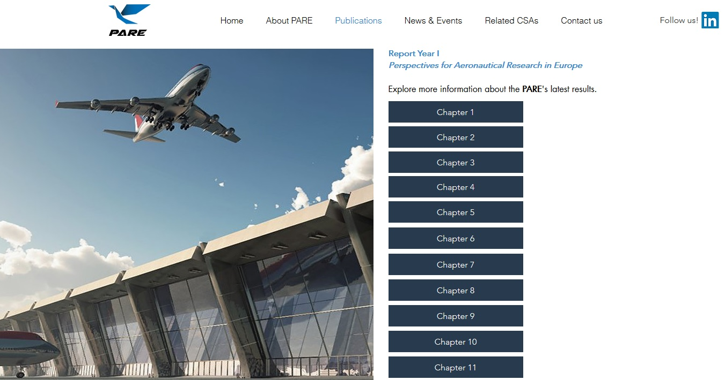

Slide 15
Thank you for your attention!
www.website.eu
www.pareproject.eu
This project has received funding from the European Union’s Horizon 2020 research and innovation programme under grant agreement No 769220. This publication [communication] reflects the views only of the author, and the Commission cannot be held responsible for any use which may be made of the information contained therein.

