Slide 1
AWSOLO Rotary Unmanned Aerial System (RUAS)
Notes:
First of all good afternoon everybody.
I am Lorenzo Fiori and I represent the Leonardo Helicopter Division.
My responsibilities in the company are for Strategy and New Initiatives and RUAS are still a new initiative although well advanced and almost ready for deployment in service.

Slide 2
Leonardo Helicopters Rotary UAS

Slide 3
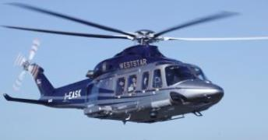
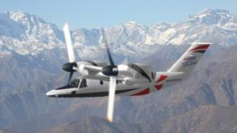
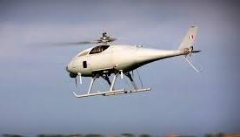
Leonardo Helicopters: 3 Strategic Pillars
HELICOPTERS
TILTROTOR
RUAV
Dual-Use concept
Family concept
All-weather
High performance
Leading Edge on Safety
Reliability and Affordability
Advanced technology
High productivity
High speed
Cost effective
Easy fit into ATM & infrastructure system
Mission operational autonomy
Advanced sensors integration
Payload
Hovering
Low-speed efficiency
Range
Speed
Altitude
Persistence
Low Cost of Ownership
Mixed Fleet

Slide 4
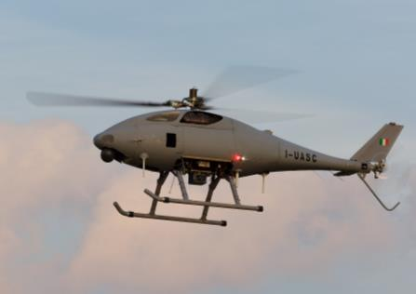
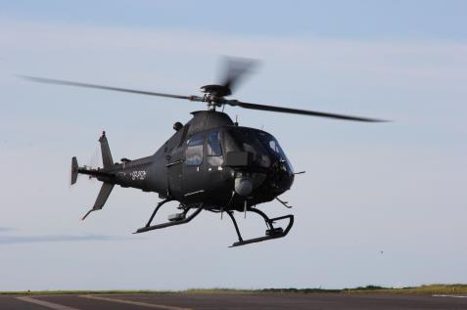
Leonardo Helicopters RUAS
Optionally Piloted
MTOW 1800kg
MTOW 205kg
Unmanned
Notes:
Leonardo activities on RUAS started beginning 2010.
Since then many progress have been made.
Today the state of the art of our projects is the following:
We are working to progress the development and homologation program of the enhanced version of HERO, Completion is expected by mid next year.
Regarding the SOLO which is an OPV derived from the single engine SW4 helicopter of our sister business unit in Poland, we have accomplished several trial campaigns such as the Unmanned Warriors at the Hebrides island last year and we are now being flying from Grottaglie the established national CoE for RPAS, without safety pilot on-board
What is also important to say is the integration of high performance sensors – particularly the maritime radar - either on HERO and SOLO, and in both case these radar are fully proprietary made by the Airborne Systems and Sensors Division of Leonardo

Slide 5
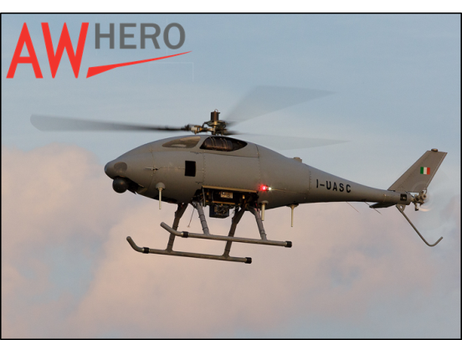
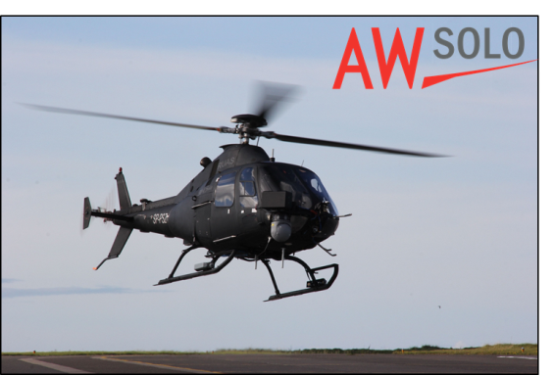
Dual-Use R-UAS
Military
Intelligence Surveillance Target Acquisition and Recognition
Force Protection
Combat Support
Route Clearance
Cargo Re-Supply
BLOS COMMs Relay
Mine Countermeasures
Anti-Submarine Warfare
Migration Control
Antipiracy
Riot Control
Civil
National Security
Border & Coastal Surveillance
Vessel Detection, Identification Monitoring and Tracking
Fishery Control
Riot Surveillance
Law Enforcement
Traffic Management
Critical Infrastructure Monitoring
Observation, Mapping, Search & Environmental Monitoring
Disaster Relief

Slide 6
The AWSOLO R-UAS

Slide 7
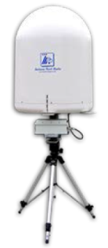
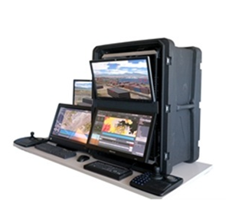
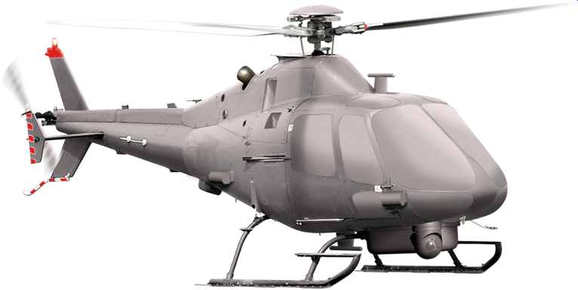
AW SOLO R-UAS Components
Ground Control Station
Data Link
Air Vehicle

Slide 8
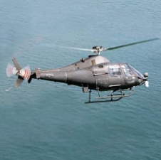
AW SOLO - Ground Control Station
Payload Operator
Station
Command & Control
Station
Payload Data
Visualization
Forward Looking
Camera with HUD
Operative Area
&
Payload
Management
C&C Interface
Equipped with
Digital Moving Map
Hardware Configurations: Rugged – Laptop – Integrated in the Control Room
Redundant Command & Control Station
STANAG 4586 Compliant
Common Ground Control Station AW HERO- AW ‘SOLO’

Slide 9
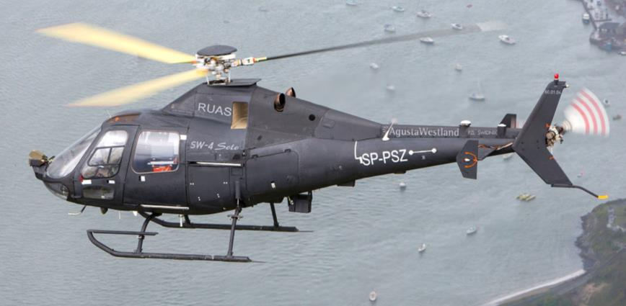
AW SOLO - Air Vehicle
Fully Articulated Main Rotor with Fiber-Epoxy Blades
Tail Rotor with two
Fiber-Epoxy Blades
Single, Turbo-Shaft Roll-Royce 250-C20R/2(SP) 450 shp
Alluminium Alloy and Fiber-Epoxy Fuselage Structure
Avionics & Functionalities:
Integrated FMS/FCS with triple redundant Architecture
Redundant Actuation System
Redundant Data-Link Architecture
Fully Automatic Take-off and Landing
Automatic Navigation
Lost-Link Automatic Recover Procedures
Automatic Autorotation on Engine Failure
AW SOLO
Performance Endurance :4.7 h ( 93kg Pld) Ceiling: 16400 ft Max. Cruise Speed: 111 KTS | Weights Empty Weight: 1353kg MTOW: 1800 kg Useful Load: 447 kg
Dimensions MR Diameter: 9 m Length: 10.6 m Width: 2.3m Heights: 3.1m | Engine Turbo-Shaft (JP-5, JP-8 )
 | Range Datalink 70 NM

Slide 10
Payloads

Slide 11
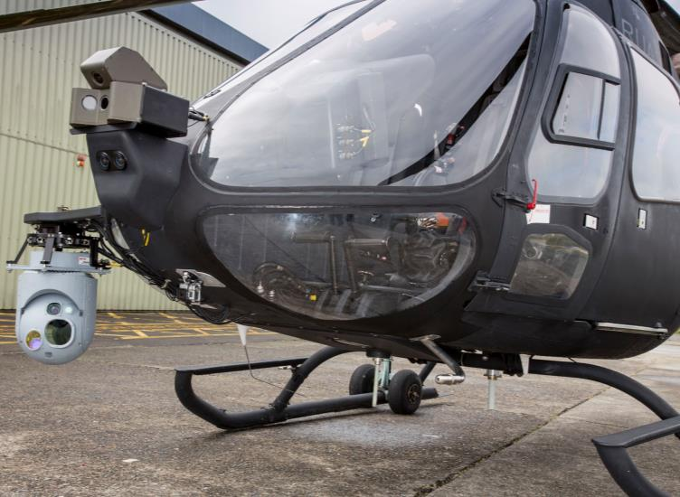
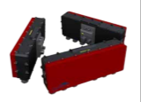
Payloads
EO/IR
AIS
LIDAR
SAR
Camera
Comms Relay
ESM
Maritime
Radar

Slide 12
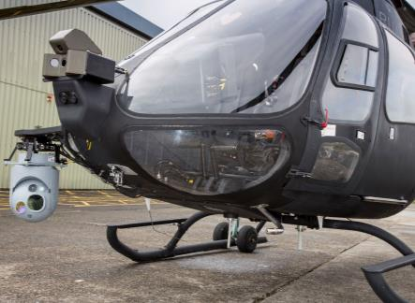
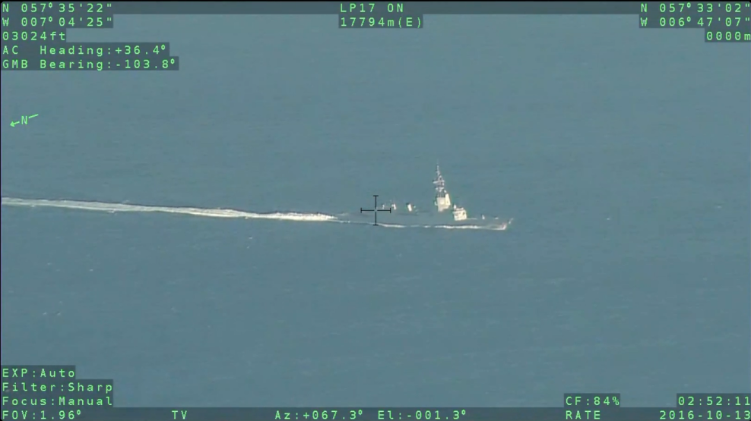
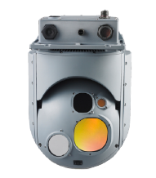
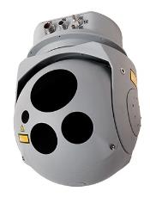
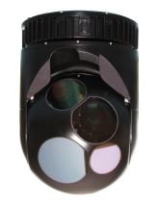
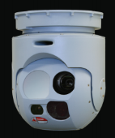
Payloads: EO/IR
DRS GS-410 Cassidian GosHawk-II Wescam MX-10 Wescam MX-8

Slide 13
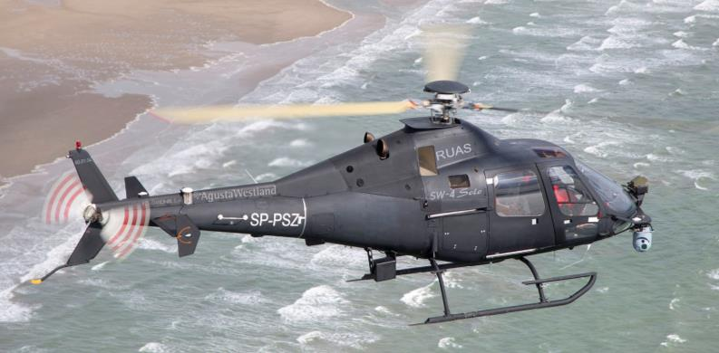
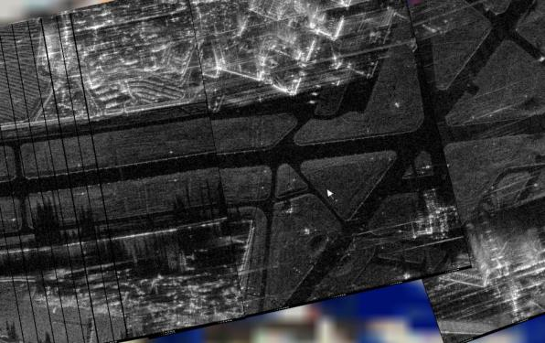
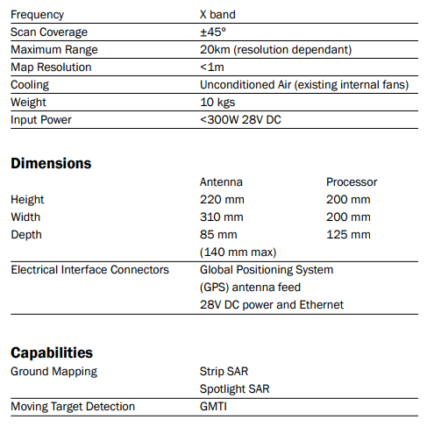
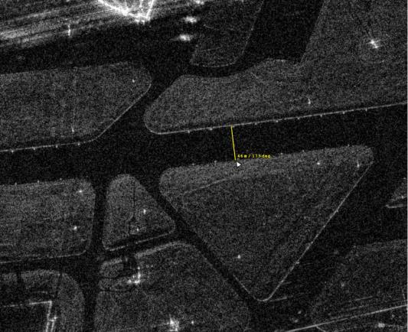
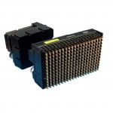
Payloads: Synthetic Aperture RADAR
Leonardo PICOSAR

Slide 14
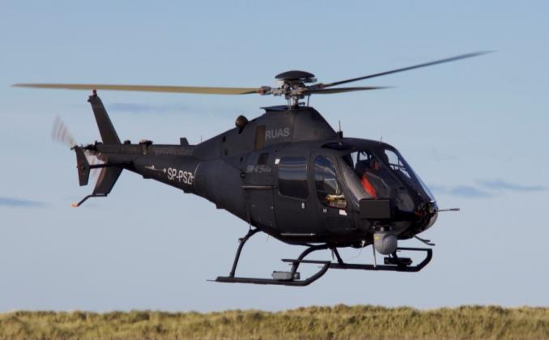
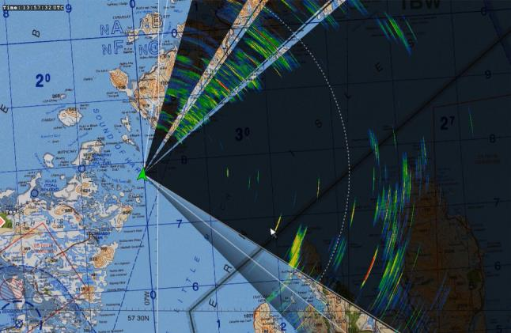
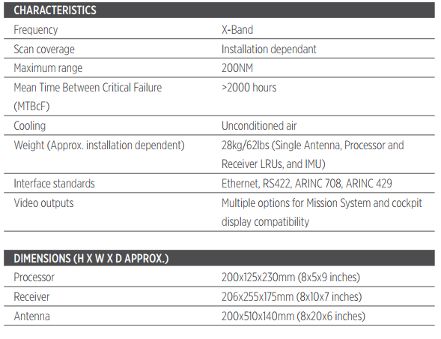
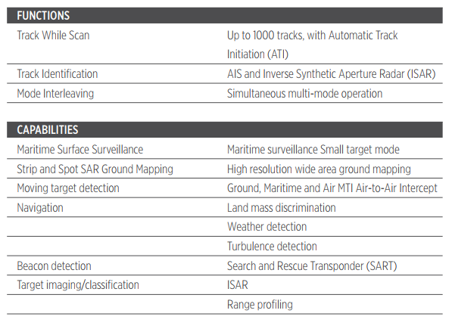
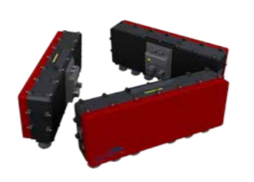
Payloads: Maritime RADAR
Leonardo Osprey 30

Slide 15
Operational Experience

Slide 16
AW SOLO R-UAS Operational Activities
Italian Blade
Where: Viterbo - Italy
When: 22 June– 3 July 2015
Sponsor: European Defence Agency
Platform: AW «SOLO»
Objective: Demonstrate Capability of ISTAR and the «Manned/unnmanned» teaming in real operational environment.
Partecpiants: 40 helicopters and 1000 military personnel
Unmanned Warrior
Where: Scotland
When: 10 – 20 October 2016
Sponsor: UK MoD
Platform: AW «SOLO»
Objective: Demonstration of the most recent unmanned systems (fixed wing, rotary wing, ground, underwater surface) and related sensors (ISTAR and command & control integration)
Participiants :Aerial, Naval, Ground systems and vessels and ships, UK MOD
CCD Demo PH1
Where : Galles - UK
When: 2013-2015
Sponsor: UK MoD:
Platform: AW «SOLO»
Objective: Demonstrate ISTAR Capability of R-UAS in real environment and shipboard operation in simulated environment.
Participiants : UAS, Naval units, UK MOD
CCD Demo PH2
Where : UK
When: 2018
Sponsor: UK MoD:
Platform: AW HERO
Objective: Demonstrate shipboard operations in real environment.
Participiants : UAS, Naval units, UK MOD
HELIMARIS
Where: Poland
When: 2016-2019
Sponsor: Polish Gov (using European Funds)
Platform: AW «SOLO»
Objective: Innovative use of OPH as platform for the maritime missions
Participiants : Aerial, Naval, CTO (Ship Design and Research Centre ) WUT, Ground systems and vessels and ships

Slide 19
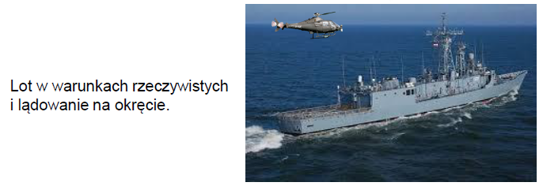

Slide 21
